Slide 2
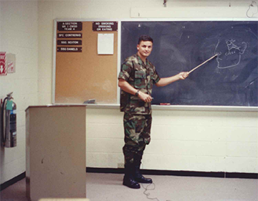
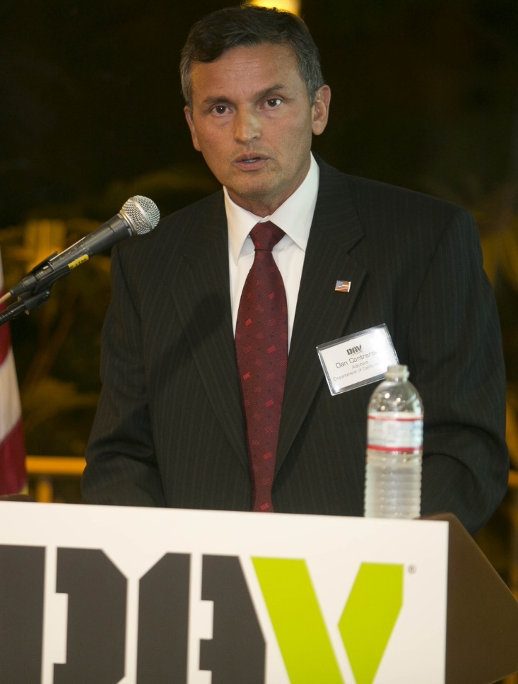

Slide 3
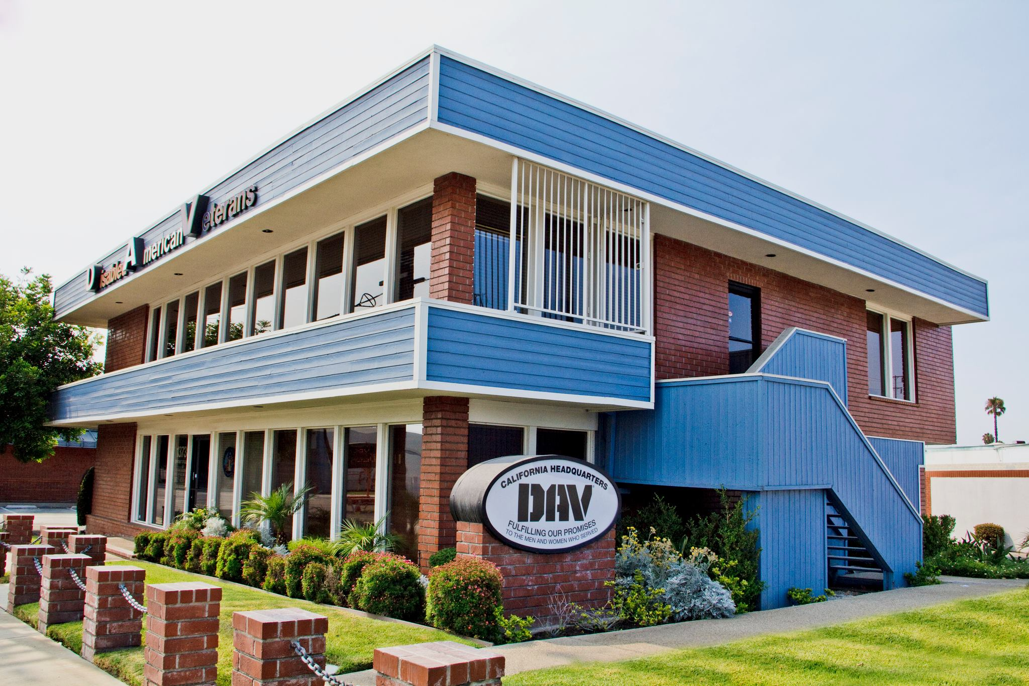

Slide 4
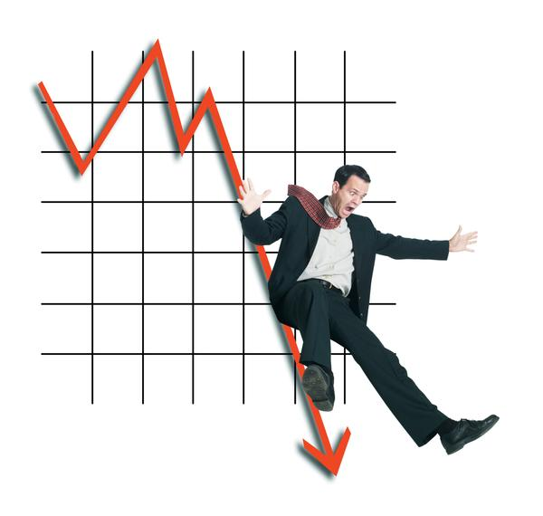
Relationships
Employee
Business/Vendor Support
Banking/Investments
California Leadership
Influencing:
An interactive process which enables us to build relationships with people to bring about a change of ideas, actions and behavior without using force.

Slide 5
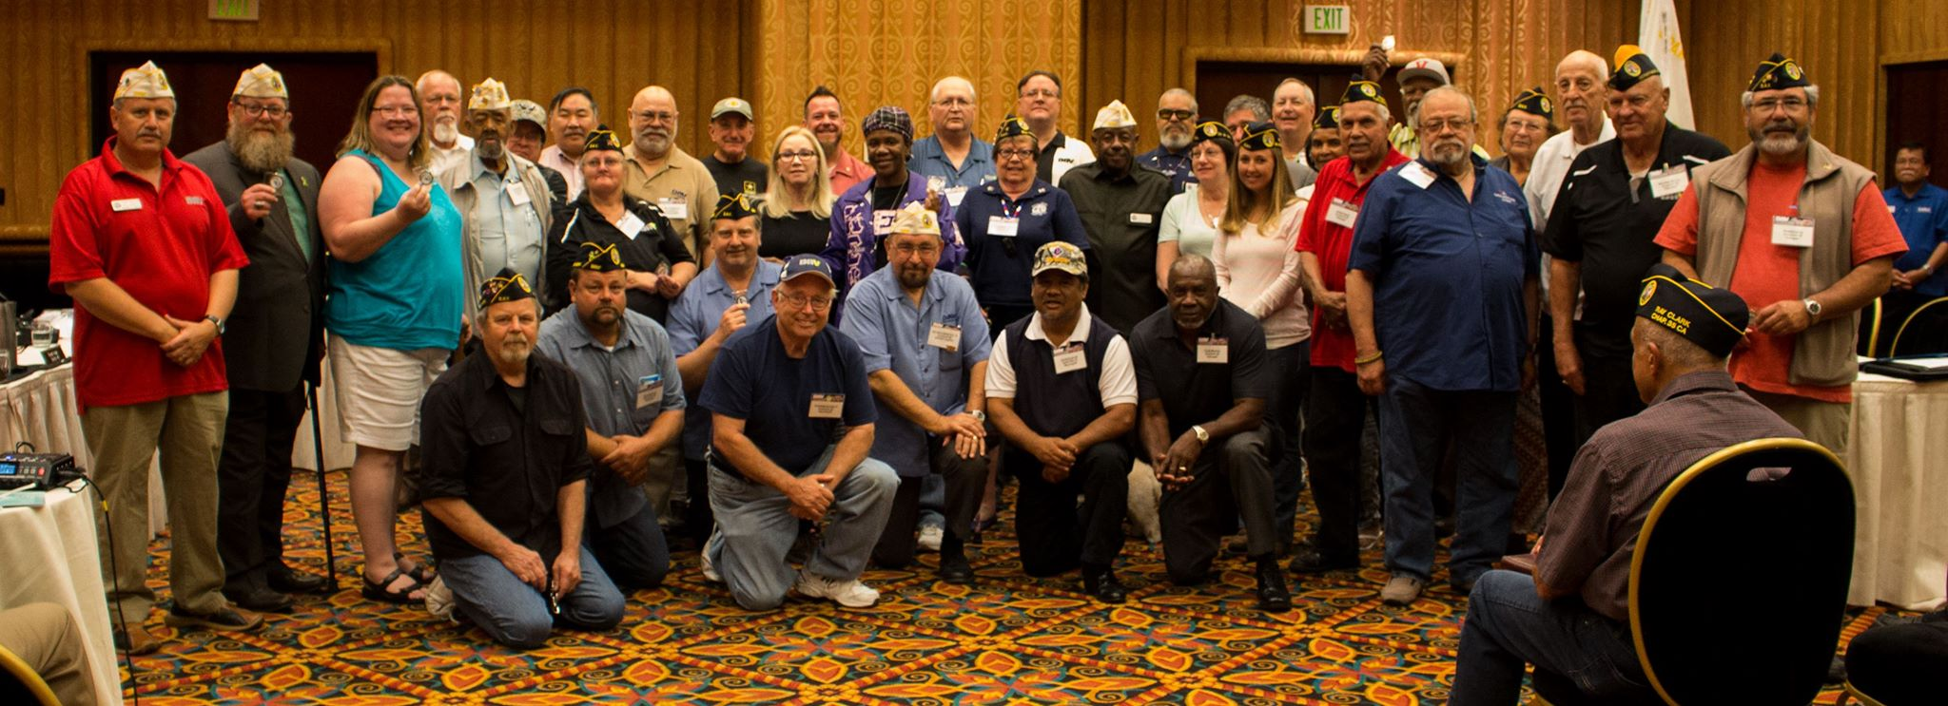
SEC & Chapter Support
Establish Goals and Objectives
SEC Training
Chapter Leadership Forum
Strengthsfinder/Thinking Outside the Box

Slide 6
Conventions
Revamp
Convention Planning Service
CCAP (Chapter Convention Attendance Program)
UCAP (Unit Convention Attendance Program)
Chapter Leadership Forum
Inform – Inspire – Entertain

Slide 7
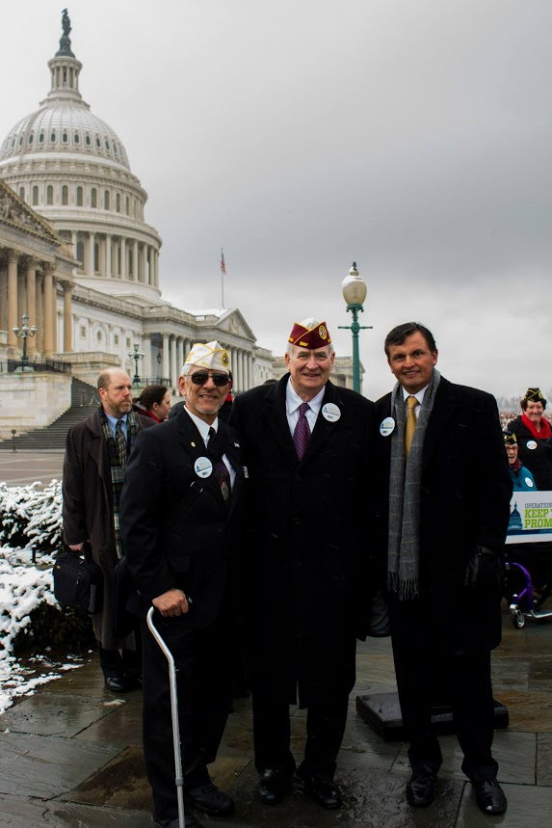
Resolutions
Restructuring
Committees
Training/Workshops
Special Interest Themes/Topics
Without Resolutions there is really no need to have conventions.
-Arthur Wilson

Slide 8
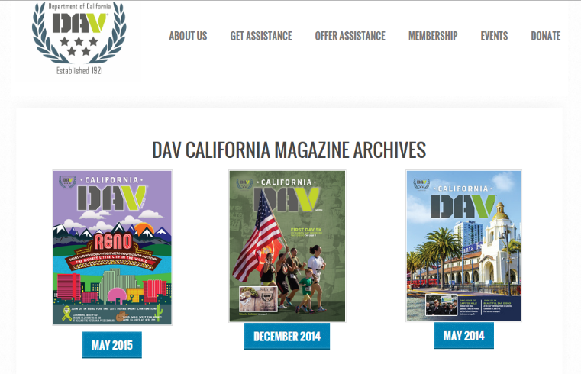
DAVCal.org
Magazine
Social Networking
Design
National Branding
DAV CA Logo

Slide 9
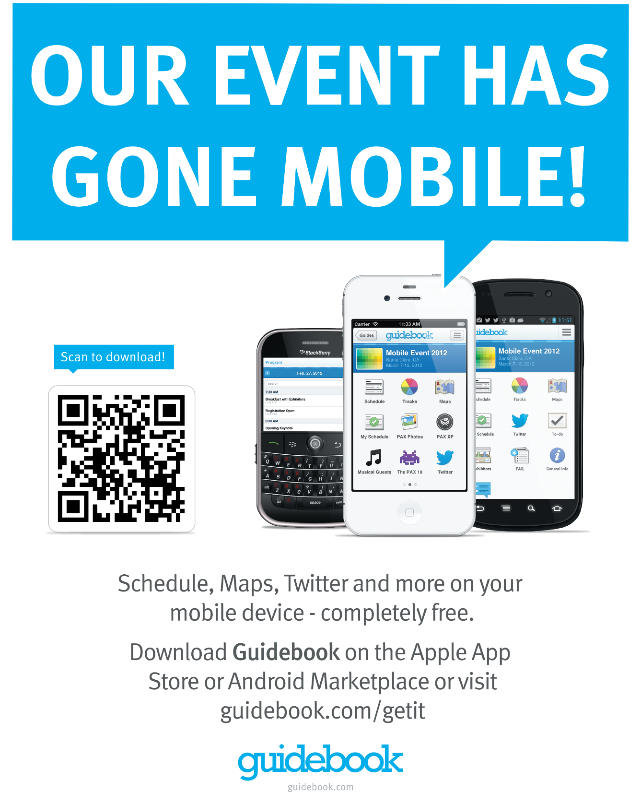

Slide 10
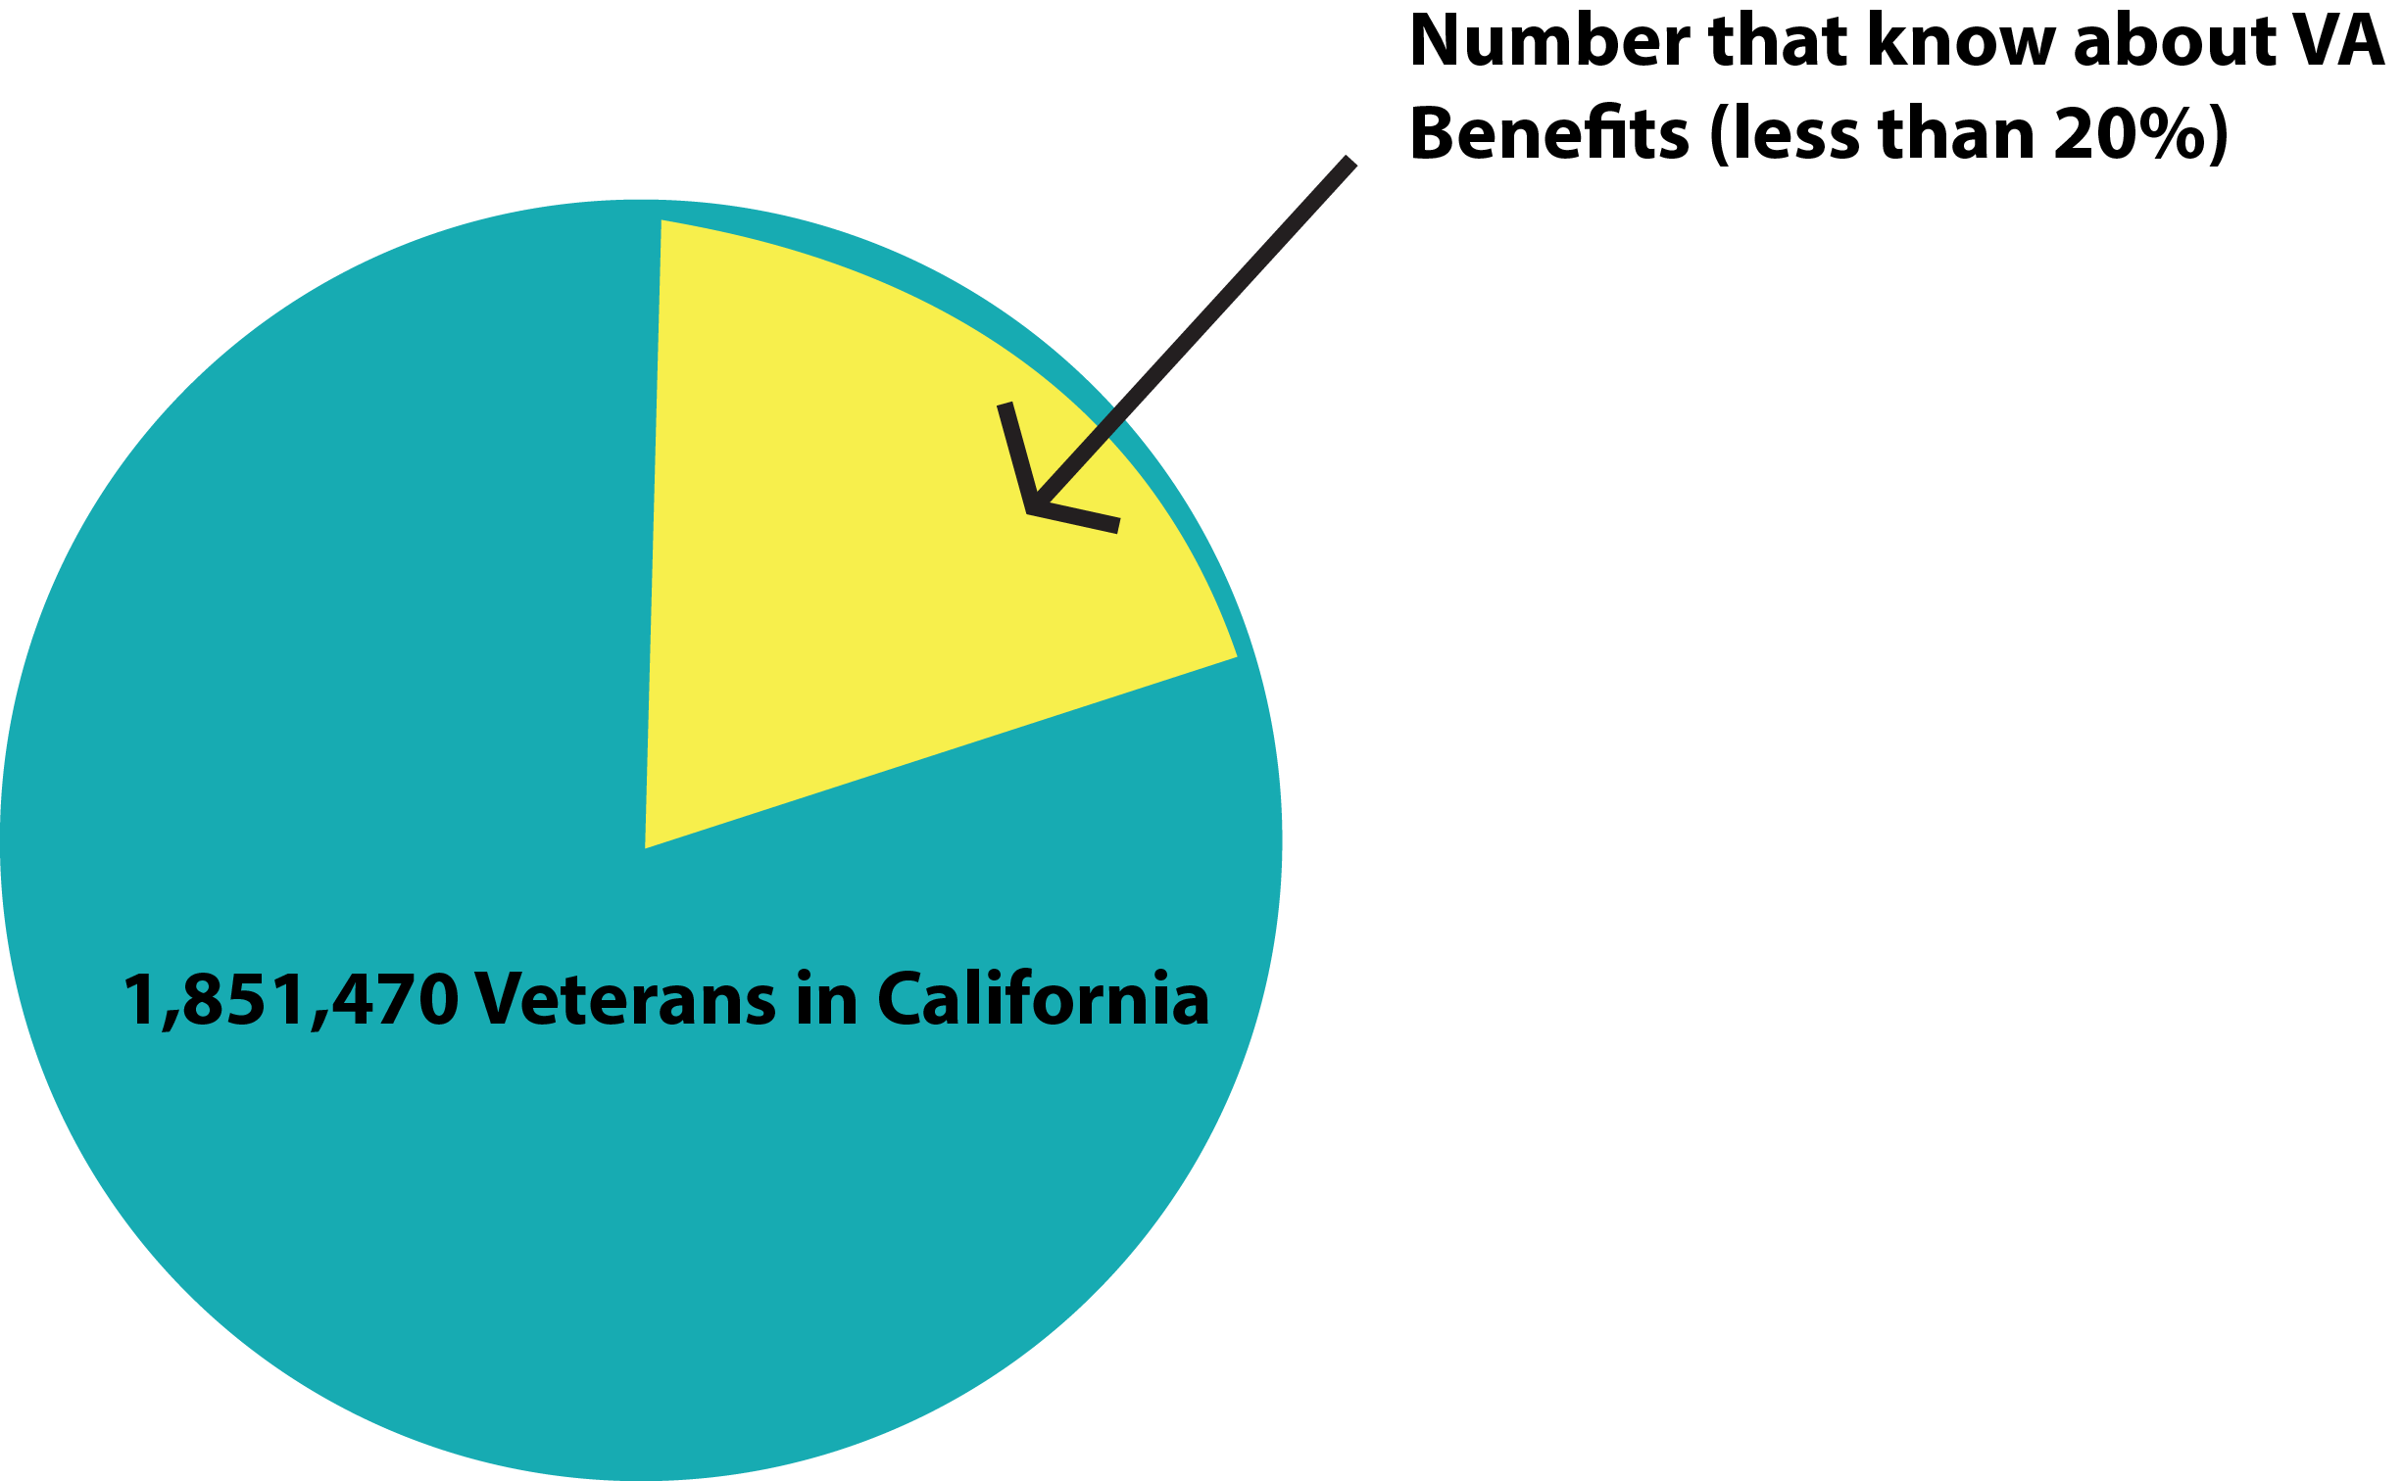
Education

Slide 11
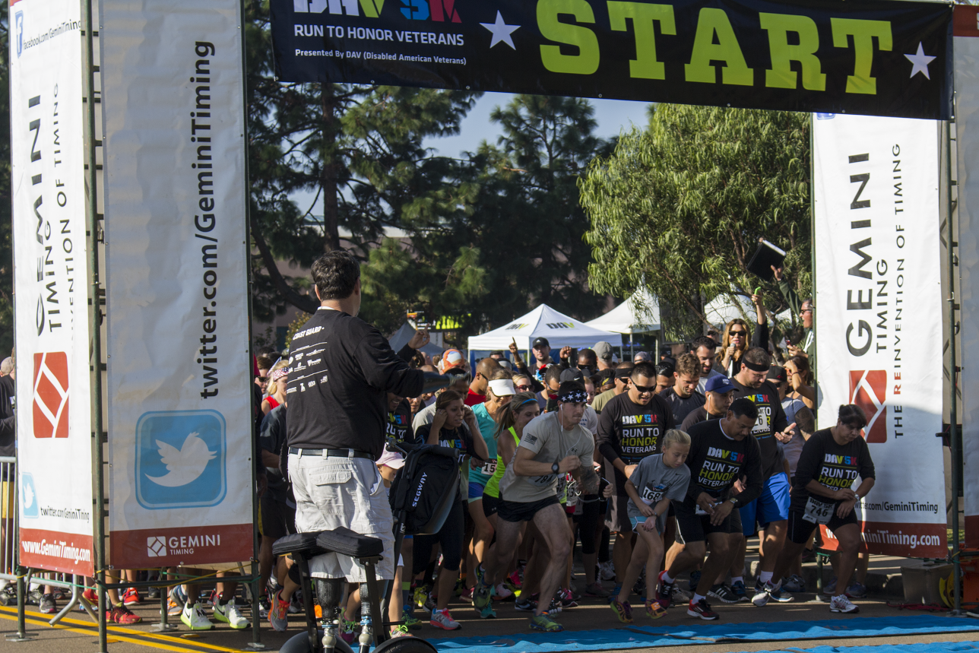
Collaboration
Info Seminars
MSO Operations
Home Depot Foundation
National Collaborations
Golden Corral/NFL Channel
Hollywood Christmas Parade
Community Heroes
DAV Job Fairs
DAV 5K
Metro Transit Authority

Slide 12
Fostering Volunteerism
VRR (Volunteer Recruitment Rally)
Hospital
Transportation
LVAP
Jesse Brown Scholarship
Time - Talent - Treasure

Slide 14
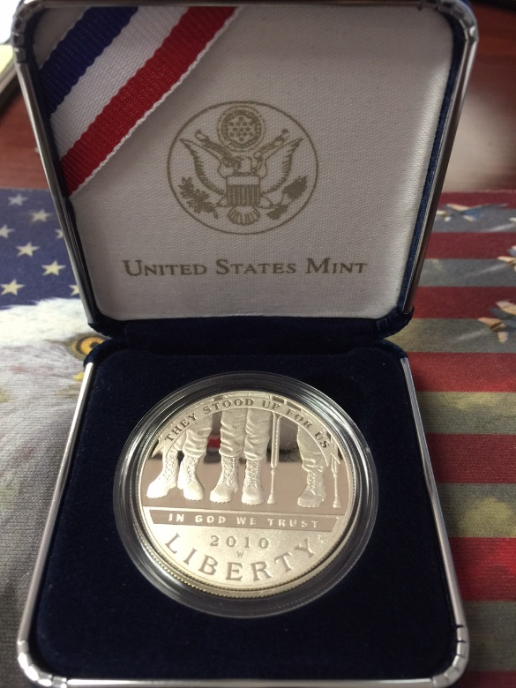
Let’s play Heads or Tails!

